Slide 1
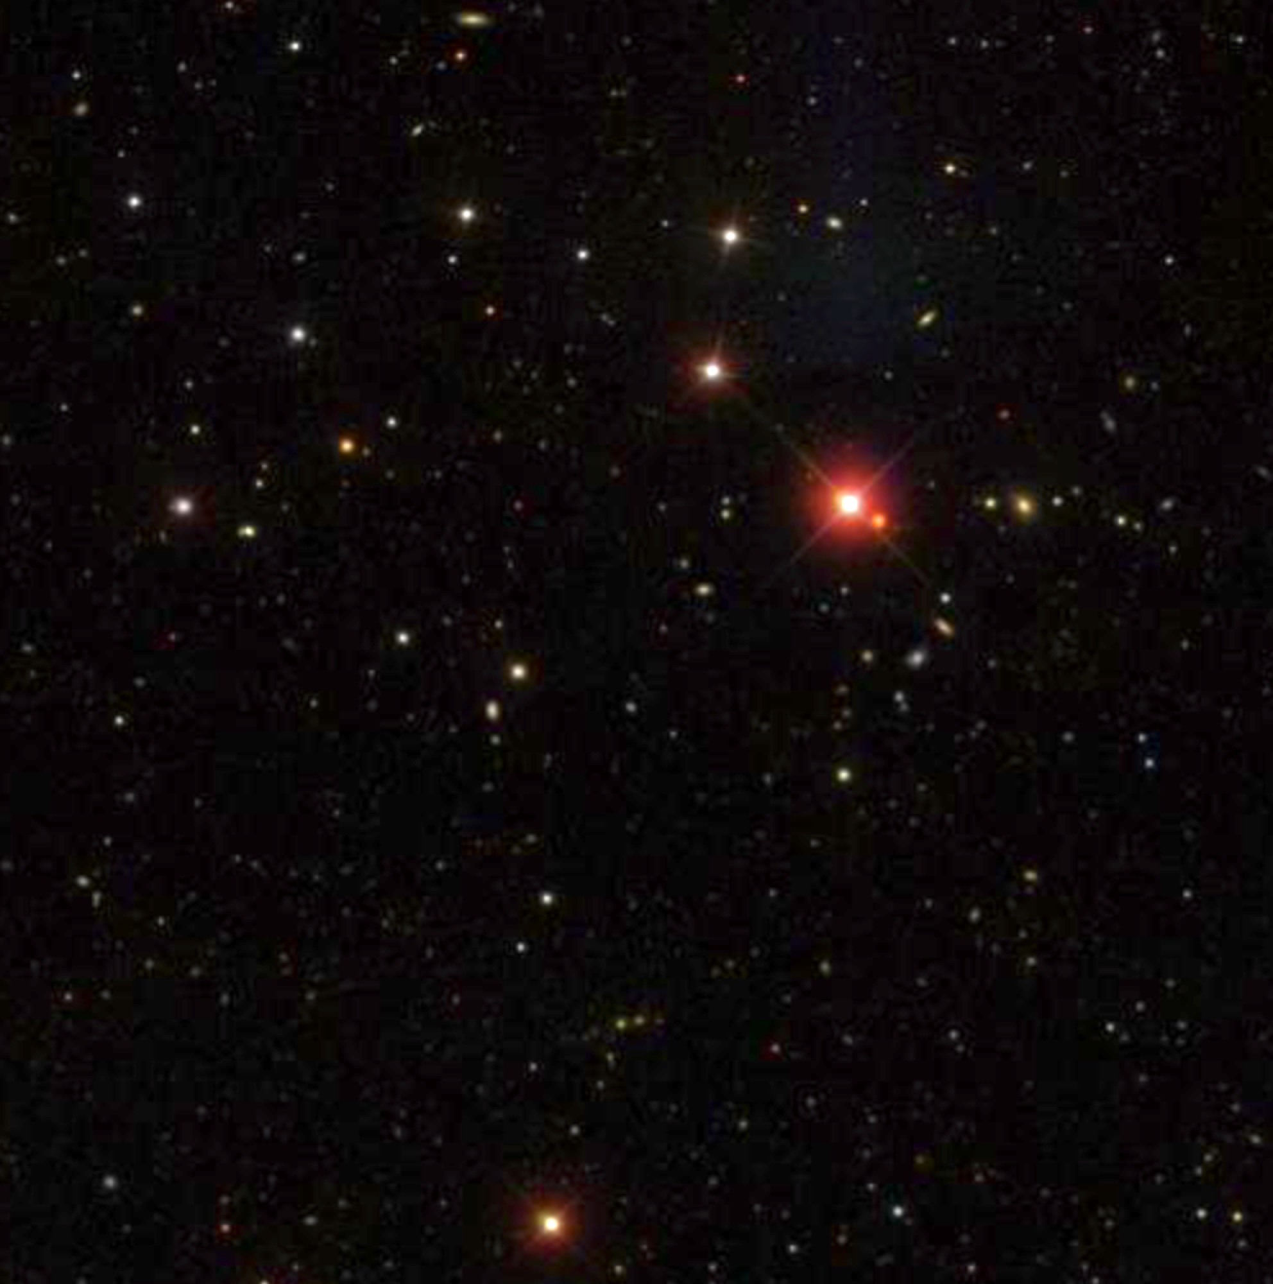
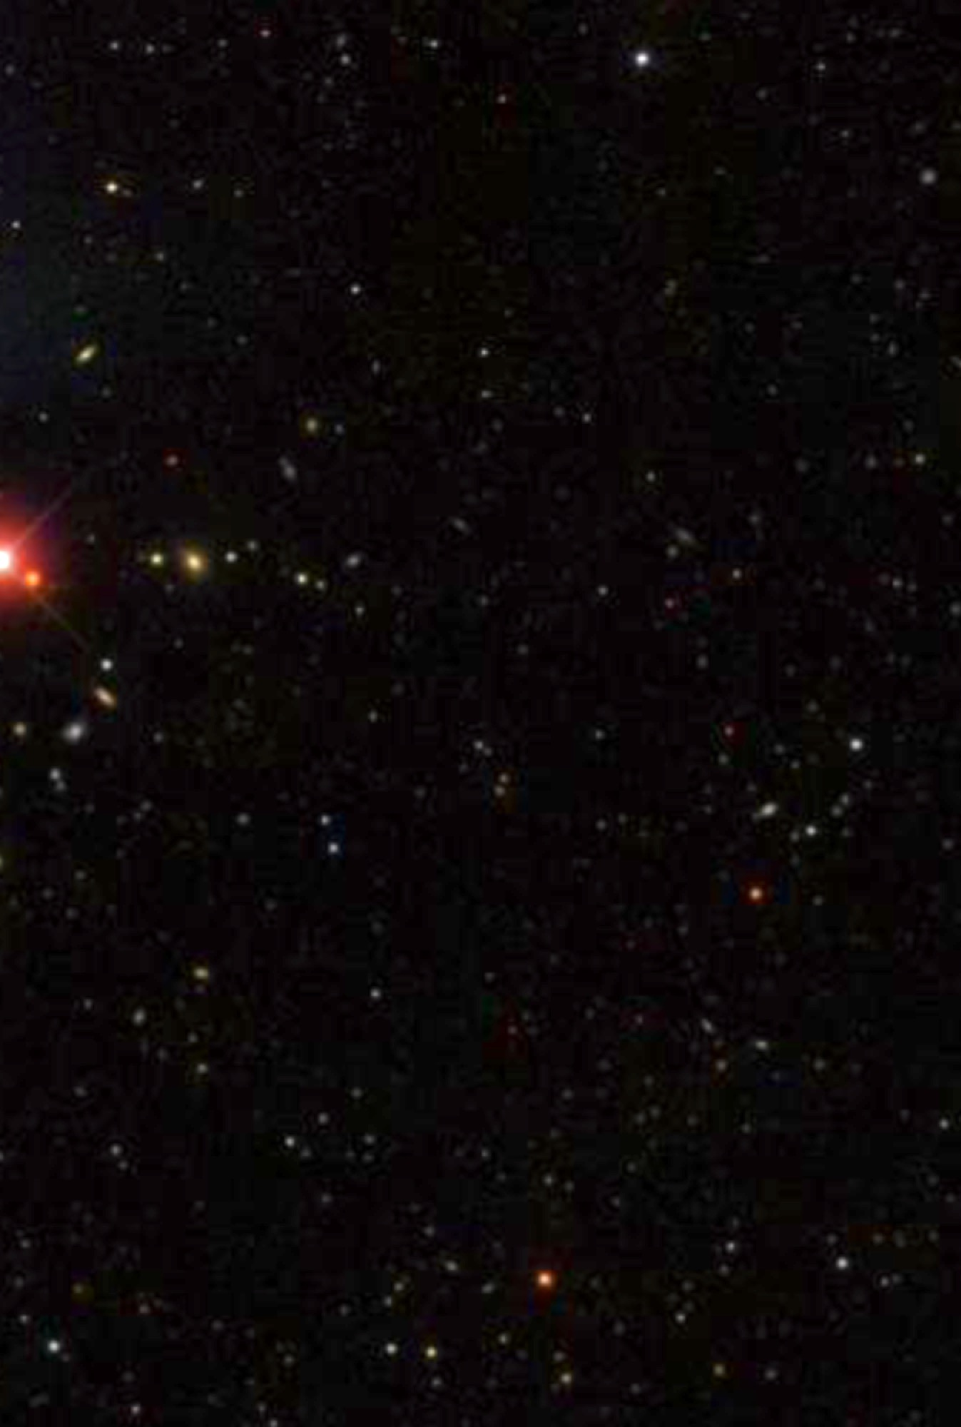
Cosmology – Historical Overview
Christopher Hirata
Physics 8803
January 9, 2019
Title image: SDSS

Slide 2
Cosmology aims to infer the scale, structure, composition, and evolution of the Universe, based on the observations that we can make from our location in space and time.

Slide 3
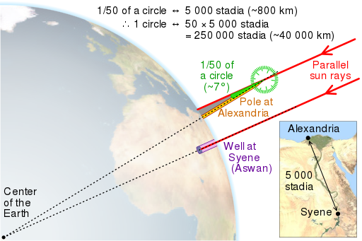
Geometry and the Scale of the Universe
Erastosthenes: circumference of the Earth (3rd century BC)
Hipparchus: distance to the Moon (2nd century BC)
Scale of the Solar System (parallax of Mars, transit of Venus – 17th/18th cenuries)
Parallax of nearby stars – 61 Cygni (Bessel 1838)
CMGLee / wikimedia commons

Slide 4
At the beginning of the 20th century …
We had observed other galaxies, but did not recognize them as such. (e.g.: the “Andromeda Nebula”)
The only astronomy was optical astronomy; the most advanced detector was the photographic plate
Planck’s constant was known (blackbody radiation) but there was no understanding of quantum theory or atomic structure
The ingredients of special relativity were being built, but the theory was not fully formulated and there was no general relativity

Slide 5
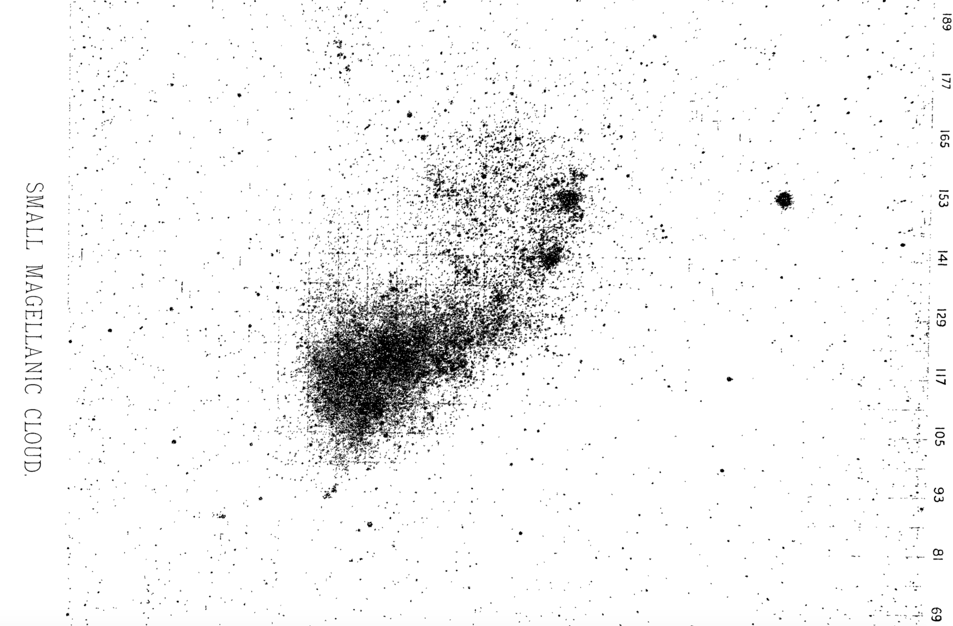
Cepheids as Standard Candles
Leavitt 1908 (5 hr exposure on a 0.6 m telescope with a photographic plate)

Slide 6
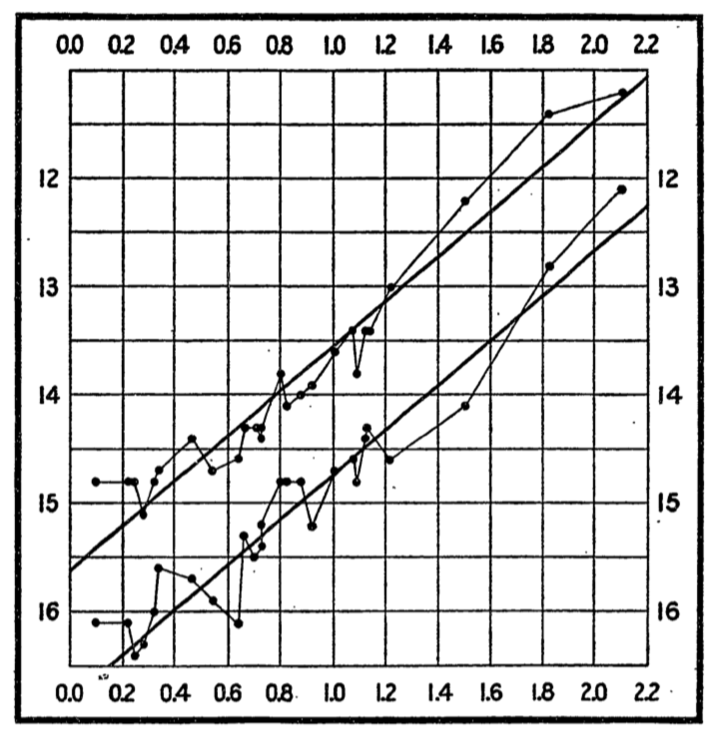
Cepheids as Standard Candles
Period-Luminosity Relation for Cepheid Variables in the Small Magellanic Cloud
Henrietta Leavitt:
Harvard College Observatory circular, 1912
“Since the variables are probably at nearly the same distance from the Earth, their periods are apparently associated with their actual emission of light, as determined by their mass, density, and surface brightness.”
Brightness
(magnitudes – log scale)
Period
(logarithm, in days)

Slide 7
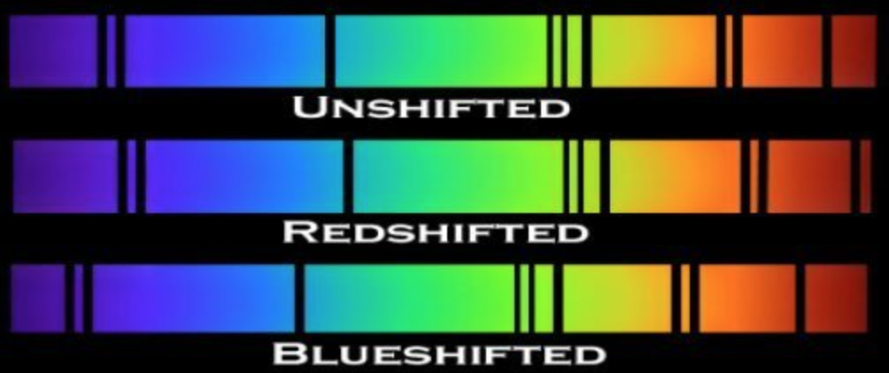
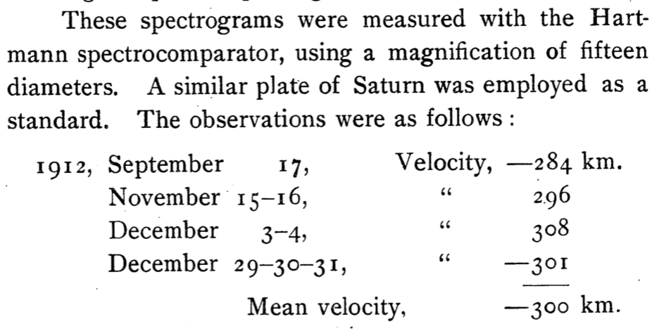
Doppler Shifts of Galaxies (before they were recognized as other galaxies!)
Earth
redshift
blueshift
“The Velocity of the Andromeda Nebula”
Vesto Slipher, Lowell Obs. Bulletin, 2:56
z = 0
z > 0
z < 0
IPAC

Slide 8
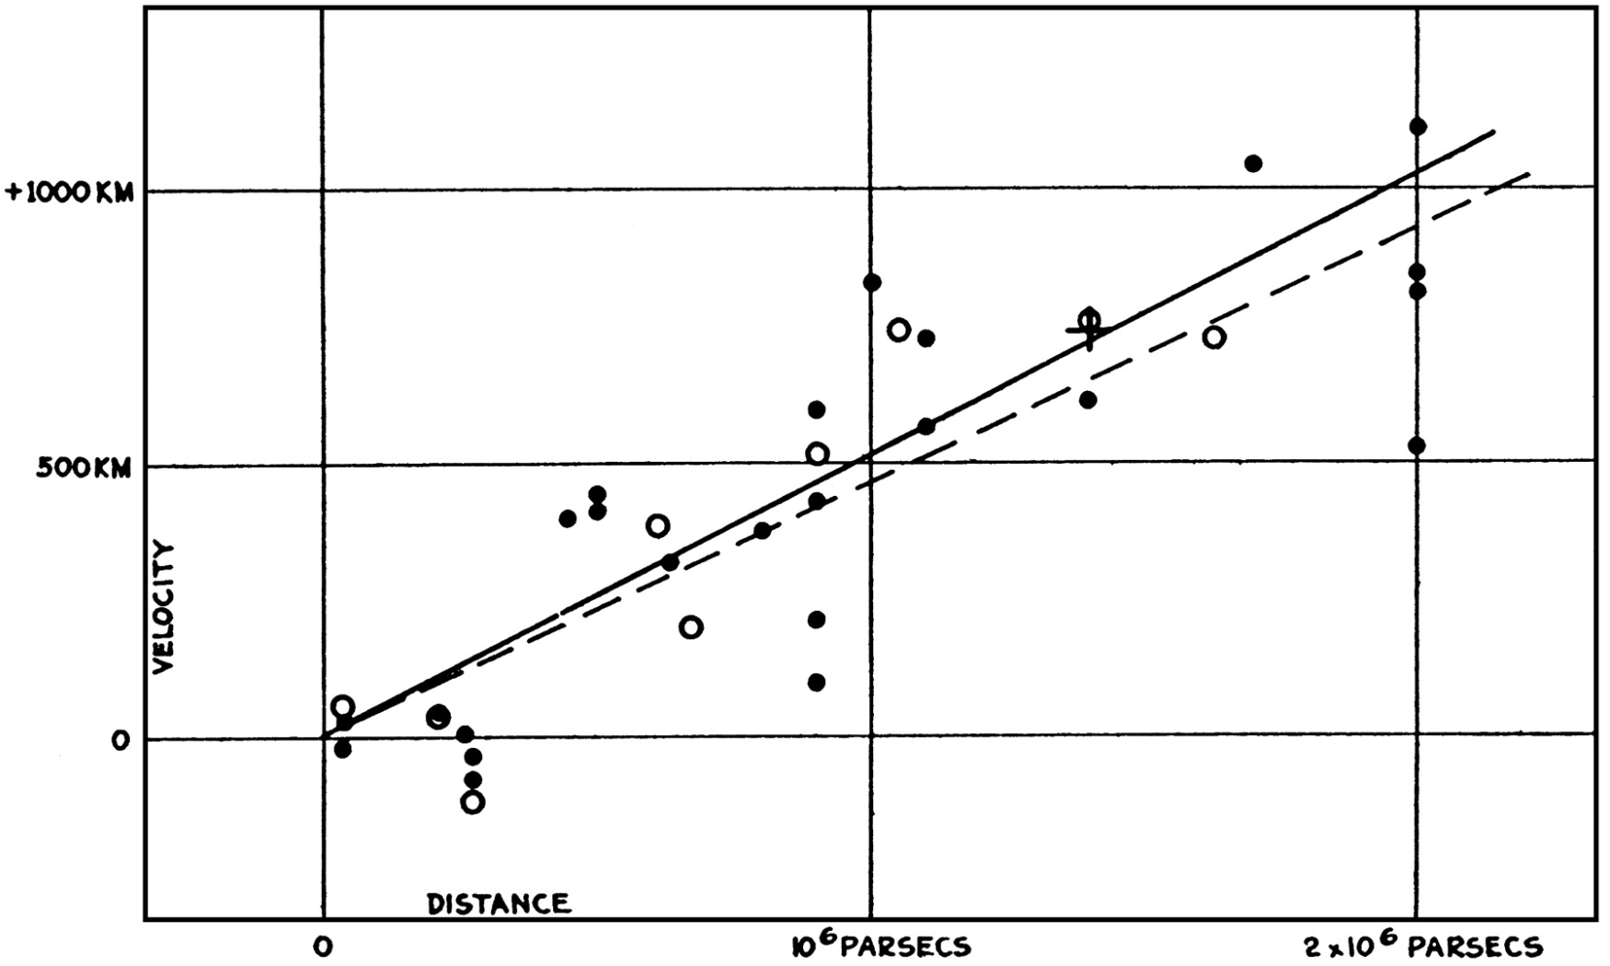
The expanding Universe
Hubble’s law on radial velocities of galaxies: v = H₀ D (velocity proportional to distance)
H₀ = Hubble constant
Modern measurement: H₀ ≈ 70 km/s/Mpc 1/H₀ ≈ 14 Gyr
Hubble’s measurement of H₀ was way too high …
Radial velocity
Distance
Hubble (1929)

Slide 9
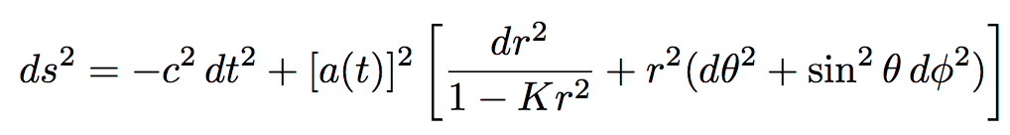
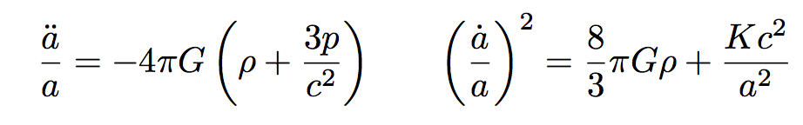
The expanding Universe
Friedmann-Lemaître-Robertson-Walker metric: (mathematical development in the 1920s and 1930s)
Describes a homogeneous, isotropic Universe in the context of curved spacetime.
Homogeneity and isotropy were initially philosophically based assumptions – today they are observationally established.
Spacetime coordinates (t,r,θ,φ)
Model has one constant (curvature K) and scale factor a(t) describing expansion history.
Dynamics in GR from the Friedmann equations:

Slide 10
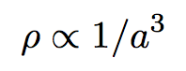
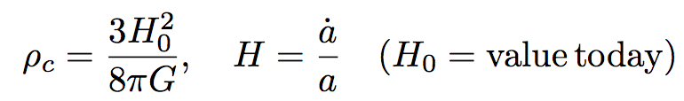
The theory of a matter-filled Universe
In a matter-filled Universe, we should have:
Thus the Friedmann equations are equations of motion for a(t).
Solution depends on how the density of the Universe compares to the critical density ρ_{c}:
For decades, the big question in observational cosmology was to measure Ω=ρ/ρ_{c}.
Shape and fate of the Universe!
This is very difficult, either by measuring ρ or a(t). As we now know, the question had to be reformulated …

Slide 11
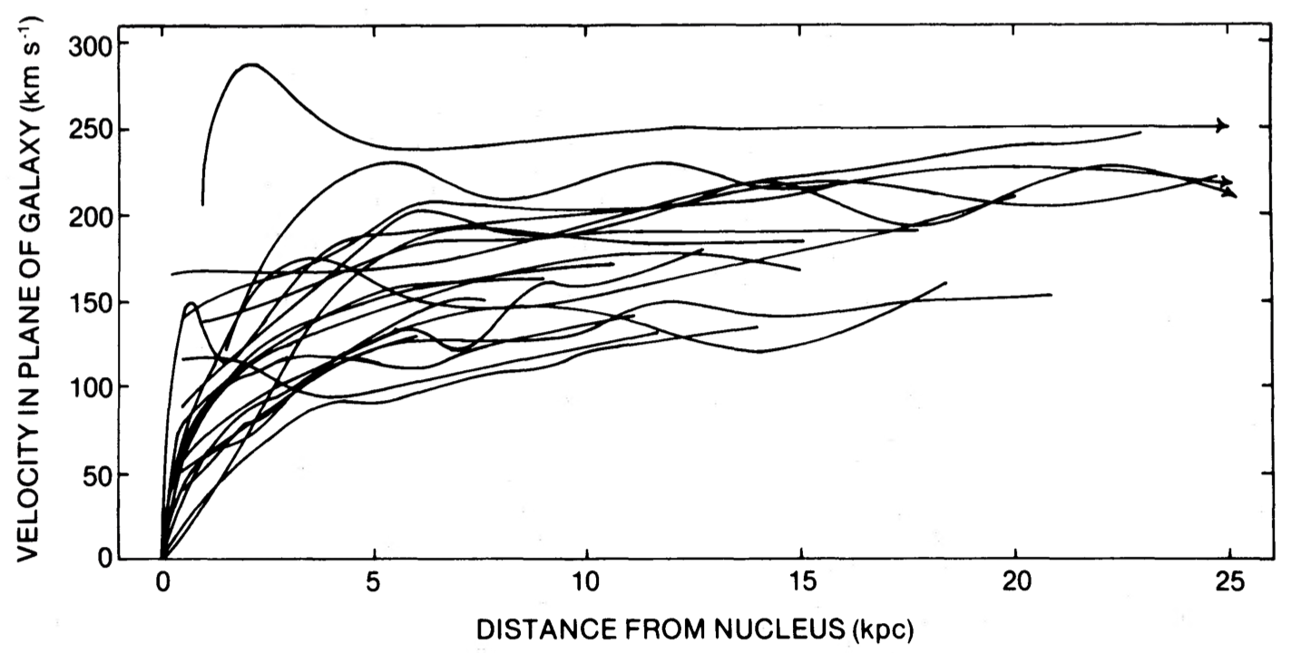
Most of the Universe is Dark!
We normally “weigh” the Universe with gravity: v² = GM/r
Planets via their moons or artificial satellites; stars (often) with binaries
Natural to try galaxies and clusters by the same method
But gravitational mass exceeds visible mass:
Coma cluster (Zwicky 1933)
Explored much more systematically via rotation of spiral galaxies (Rubin et al.)
Now known that most dark matter is:
Non-baryonic in nature (Big Bang Nucleosynthesis)
Not in large compact objects (microlensing – 1990s)
Can still try to measure a(t) by other means – distance vs. redshift. This was successfully done in the 1990s with surprising results, but I want to consider another thread of history first.
Rubin et al. (1980)

Slide 12
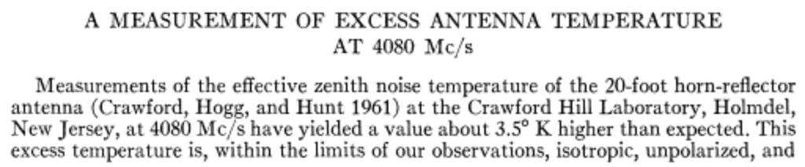
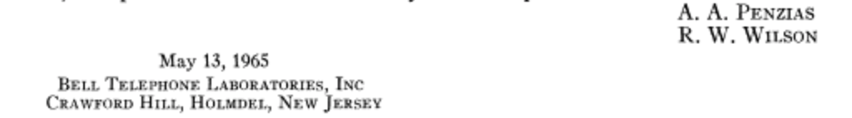
The Cosmic Microwave Background
Radiation at a temperature of 2.7 K seen in all directions
Discovery – Penzias & Wilson (1965), Nobel Prize!
Matches a blackbody spectrum (i.e. the spectrum when all frequencies are in equilibrium at the same temperature)
…
…

Slide 13
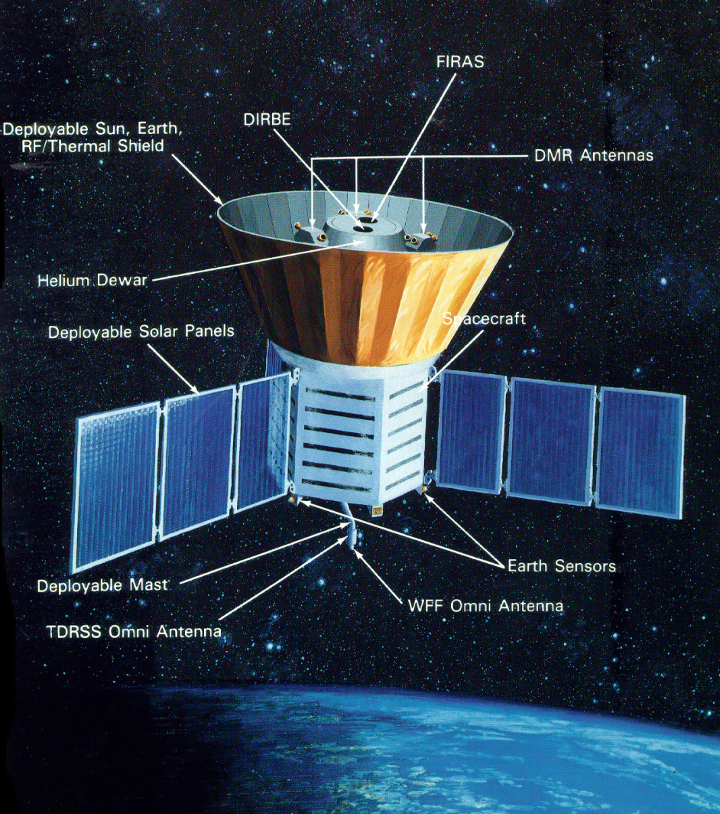
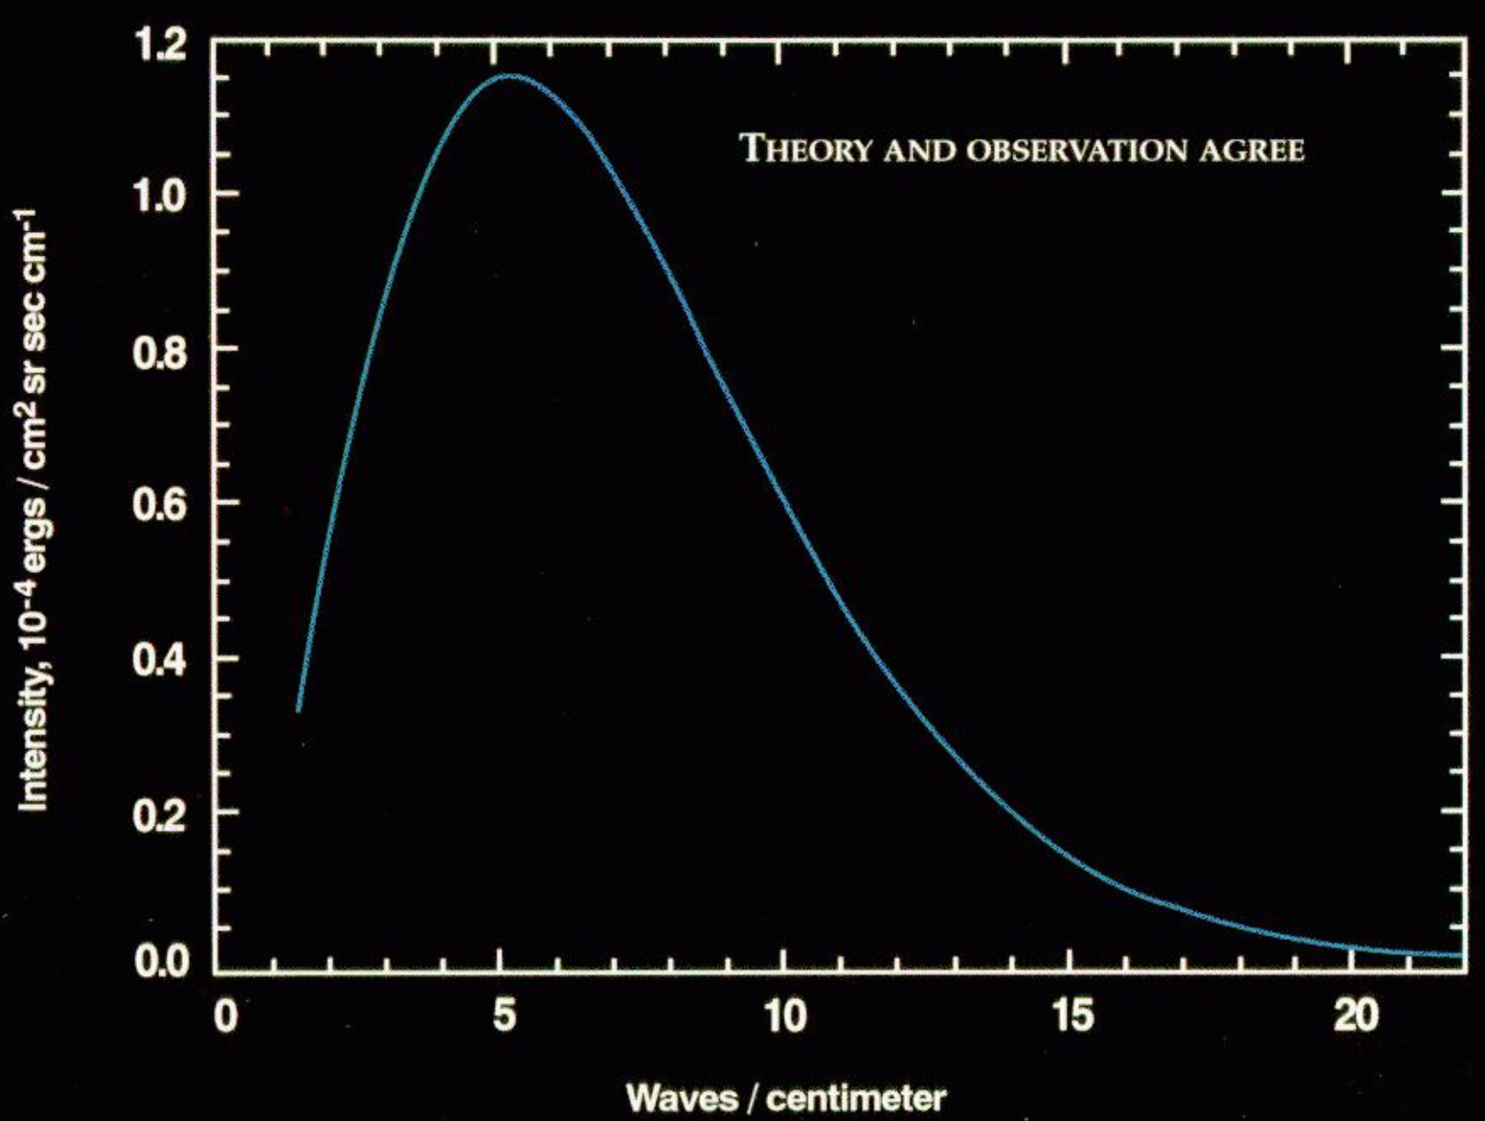
COBE – 1989
Anisotropy measured by DMR: structure in the early Universe
Spectrum Measured by the COBE satellite, 1992

Slide 14
Origin of the fluctuations?
Observable features in the CMB were imprinted when the Universe became transparent (T ~ 3000 K for hydrogen plasma, or z=1000)
But the Universe was too young for information to travel between these regions – so:
Why is the Universe so uniform?
and how did the perturbations develop?
Leading explanation is inflation, developed in early 1980s
Period of exponential expansion solves communication problem
Perturbations are quantum fluctuations stretched to cosmic scale
Many successes in CMB statistics (Gaussianity, adiabaticity, near-scale-invariance …) but inflation remains a theory
potential energy V(φ)
scalar field φ

Slide 15
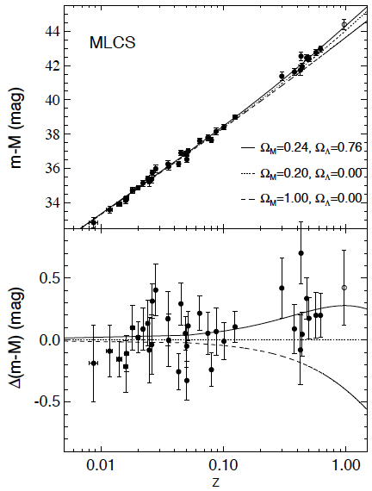
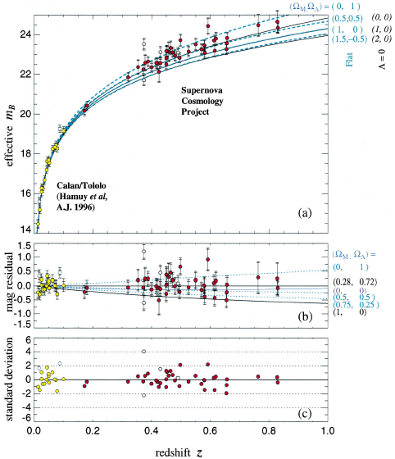
Cosmic acceleration (“dark energy”)
1998-9: Discovery of accelerating Universe from Type Ia supernovae. There is some new field or force that causes all of space to be repulsive.
fainter
moving away from us faster
Riess et al, Perlmutter et al

Slide 16
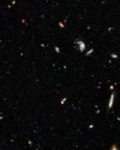
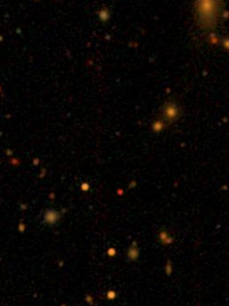
History of the Universe
300 kyr
Recombination:
First atoms
Universe becomes
transparent
T ~ 3000 K
Hot & dense
7 Gyr
Universe
starts
Accelerating
T_{CMB} = 5K
Cold & dilute
300 Myr
First stars
and galaxies
T_{CMB} ~ 40K
10⁻³⁸ s?
Inflation?
3 min
First nuclei
T ~ 10⁹ K
14 Gyr
Today
T_{CMB} = 3K
?
ACBAR
NASA/ESA/Z. Levay
SDSS

Slide 17
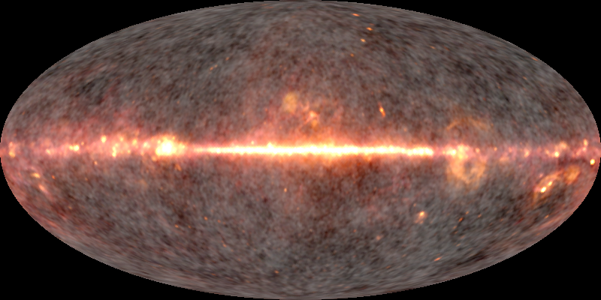
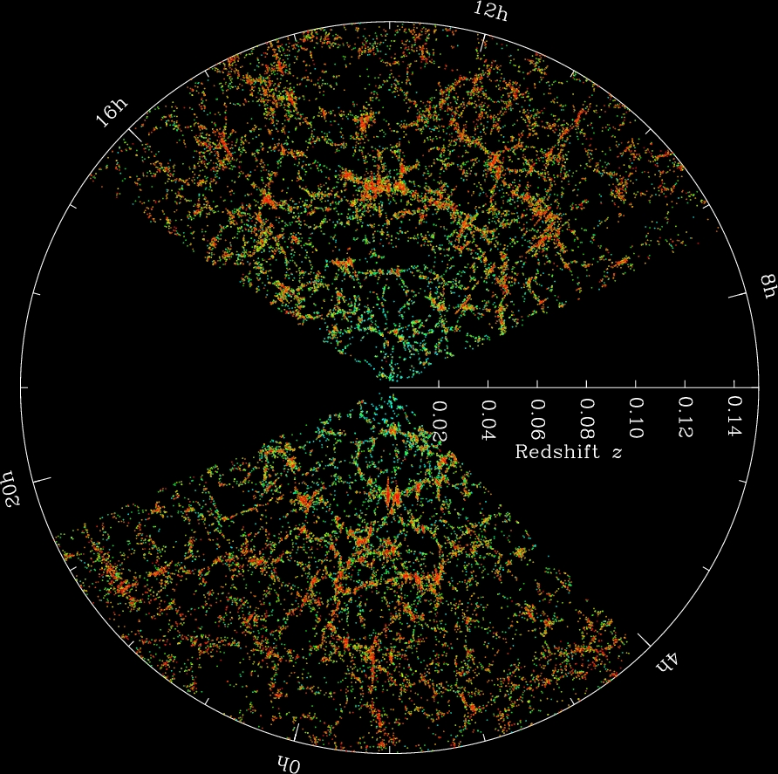
Modern Statistical Cosmology
The Cosmic Microwave Background (WMAP)
The Galaxy Distribution (SDSS)
Goal: To learn about the composition of the Universe, and the laws governing the largest scales, by comparing the statistical properties of the Universe across cosmic time …
and to use the perturbations to learn about the earliest moments of the Universe.
Only in a statistical sense are the structures that we see at different epochs the same.

Slide 18
The microwave sky as seen by WMAP [launched 2001]
Composite of 22, 41, and 94 GHz sky maps from WMAP

Slide 19
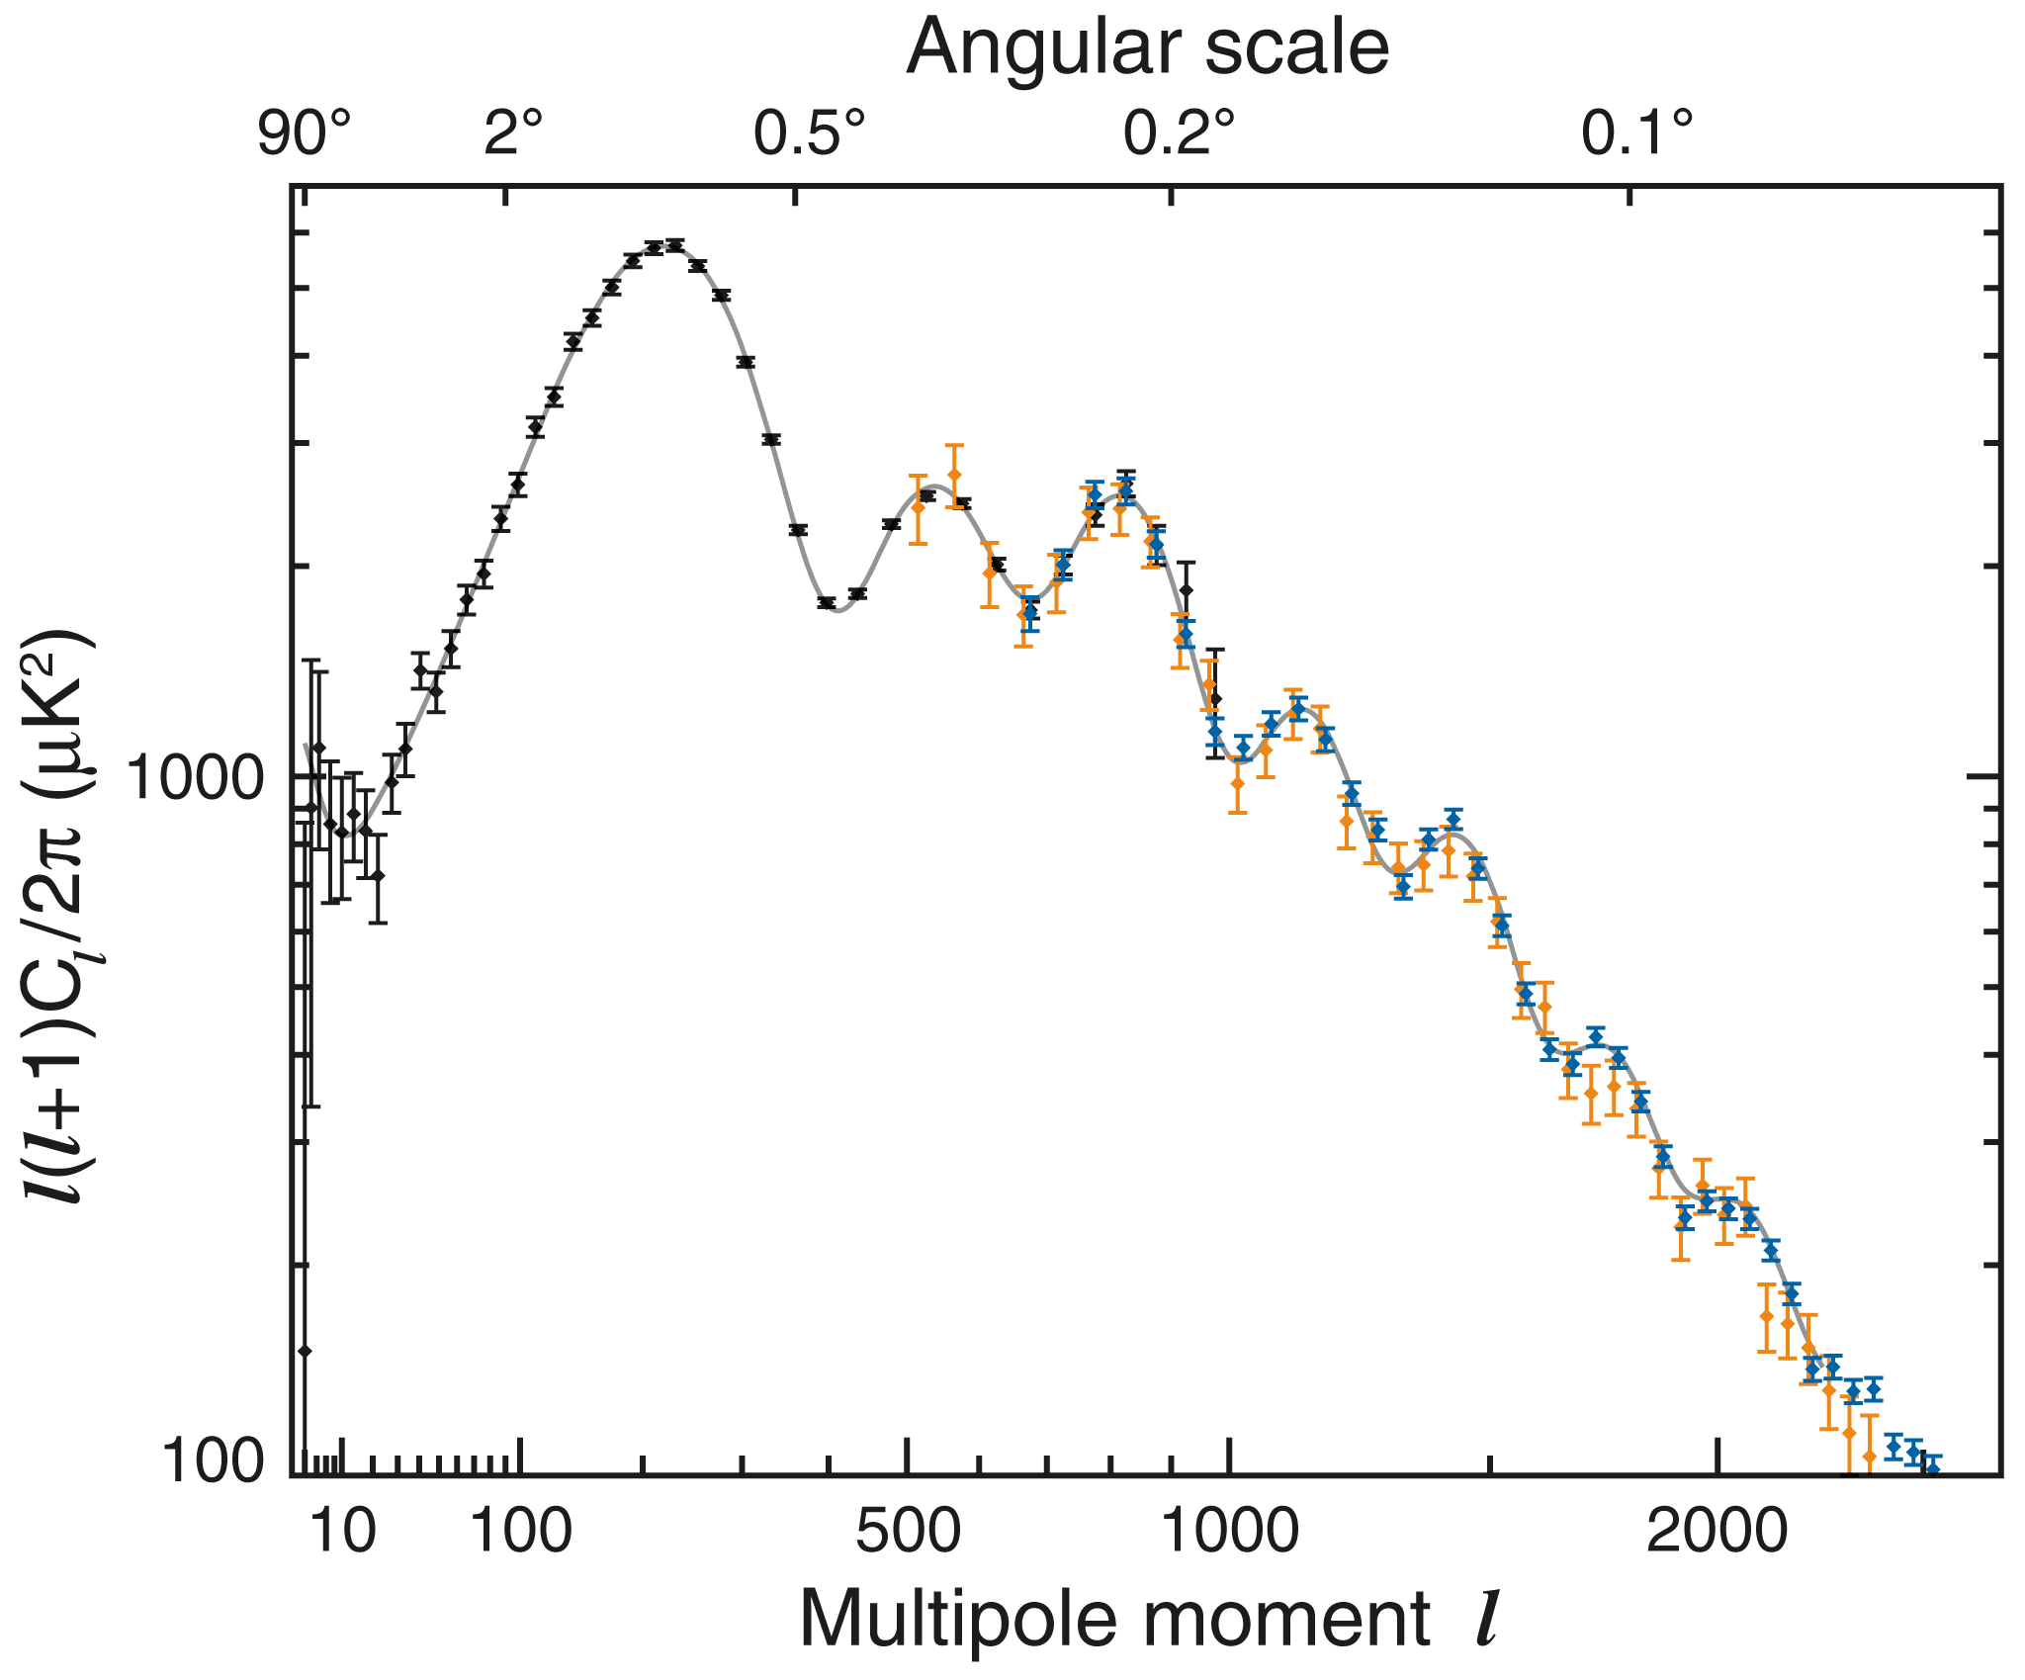
CMB Anisotropies: Seismology of the early Universe
Baryon:photon ratio
(6.10±0.10)×10⁻¹⁰
by number
Dark matter:baryon ratio
5.05±0.16
by mass
Initial density perturbations
(4.93±0.09)×10⁻⁵
standard deviation per logarithmic range in scale
Black = WMAP
Blue = SPT
Orange = ACT
(Hinshaw et al. 2010
WMAP final data release paper)

Slide 20
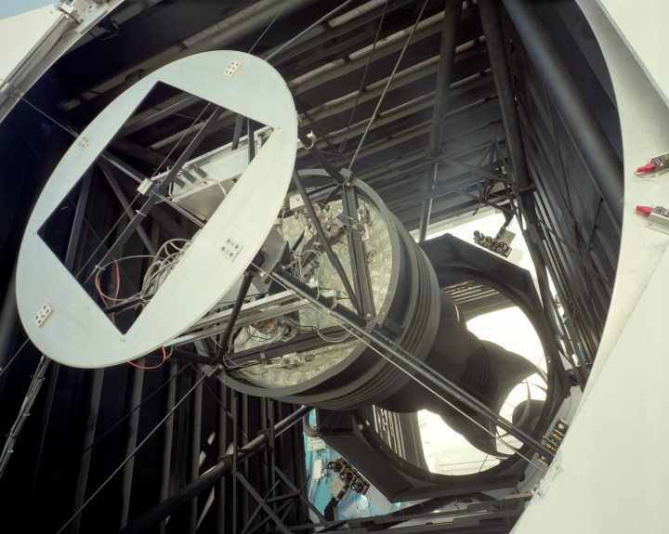
The Sloan Digital Sky Survey
Uniform digital images of ¼ of the sky, >1 million spectra
SDSS
Notes:
Uniform digital images + spectra

Slide 21
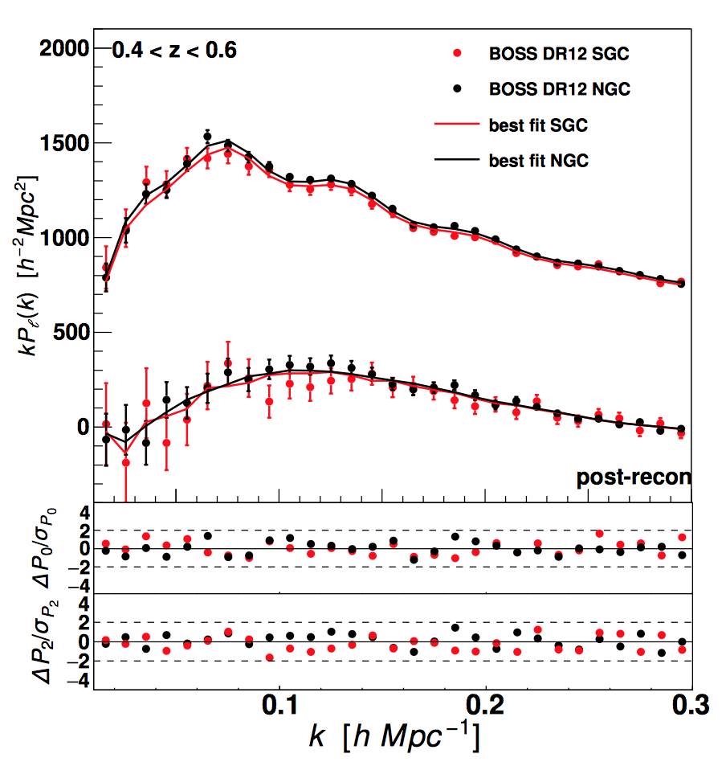
Statistics of the Distribution of Galaxies
The same oscillations as seen in the CMB!
Can find best-fit models to both the CMB and the local Universe.
Planck + SDSS-BOSS:
Total matter fraction of the Universe =
30.1±1.4%
(Alam et al. 2016)
Beutler et al. 2016

Slide 22
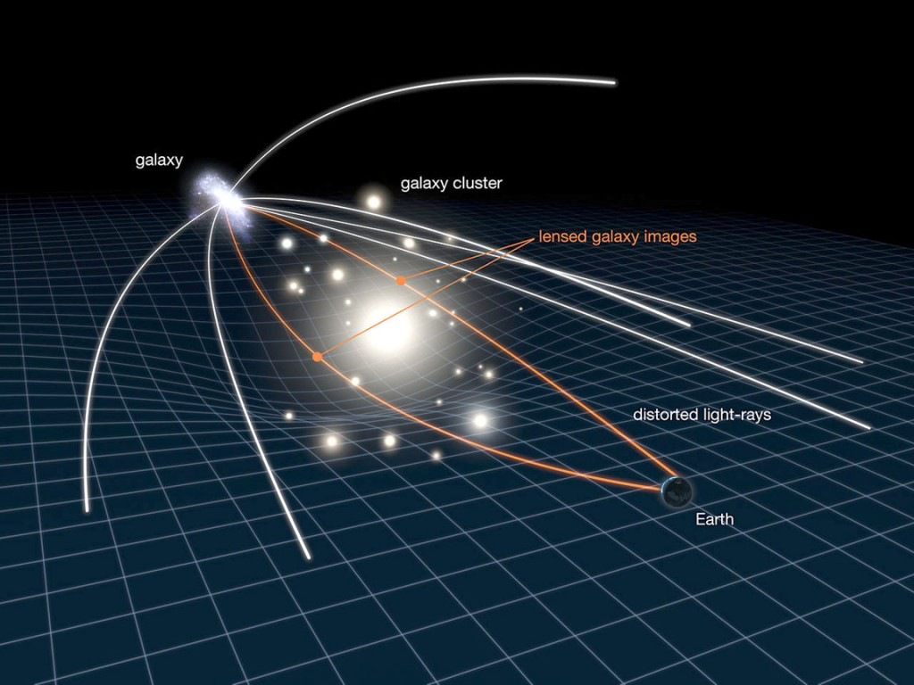
Gravitational lensing
NASA/ESA

Slide 23
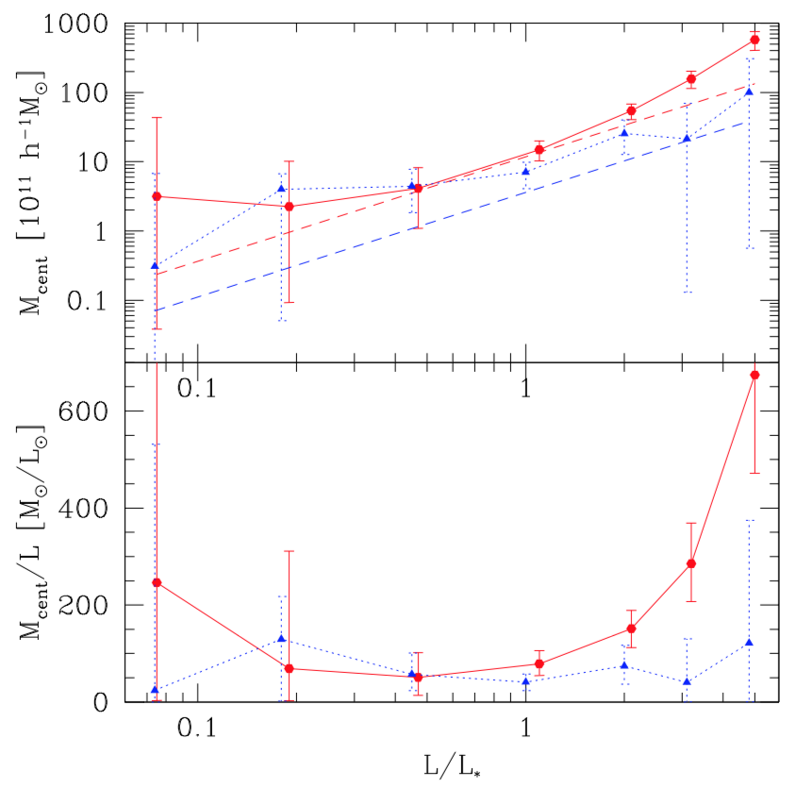
Weak lensing by galaxies
Ellipticals
Spirals
Mass of galaxy + halo, including
dark matter [7x10¹⁰ solar masses]
Luminosity of the galaxy [L*]
Mandelbaum et al. 2006

Slide 24
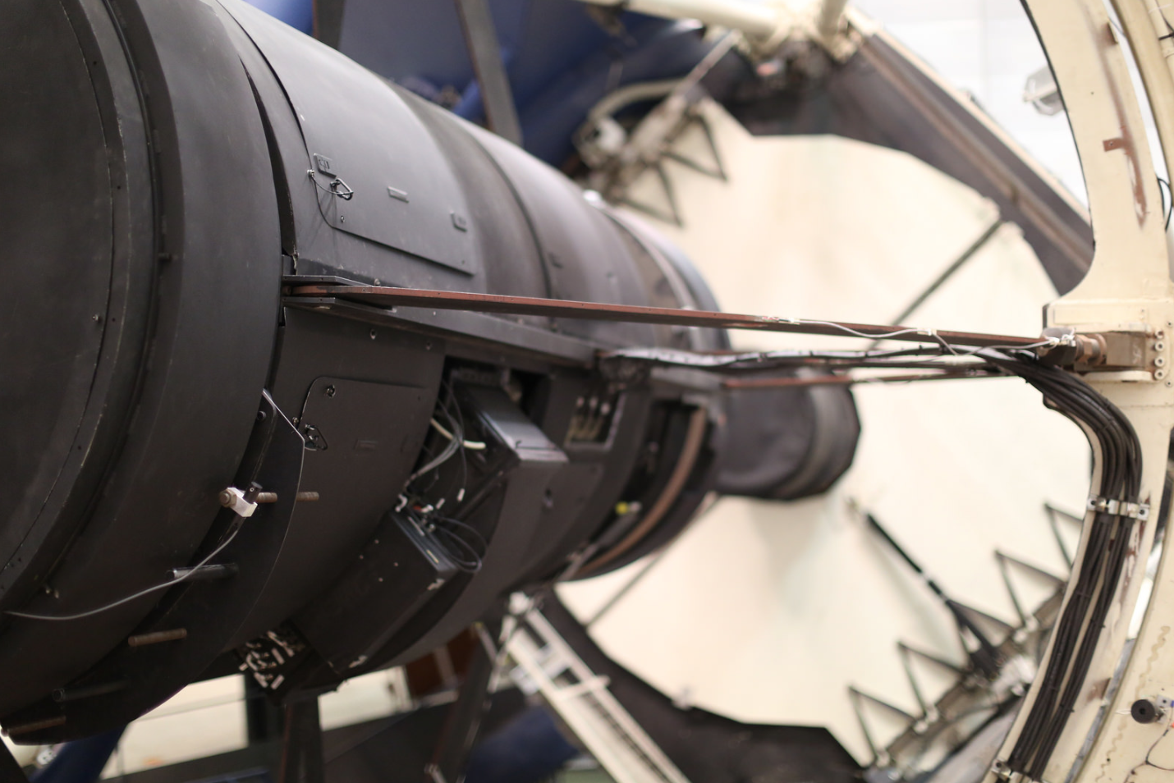
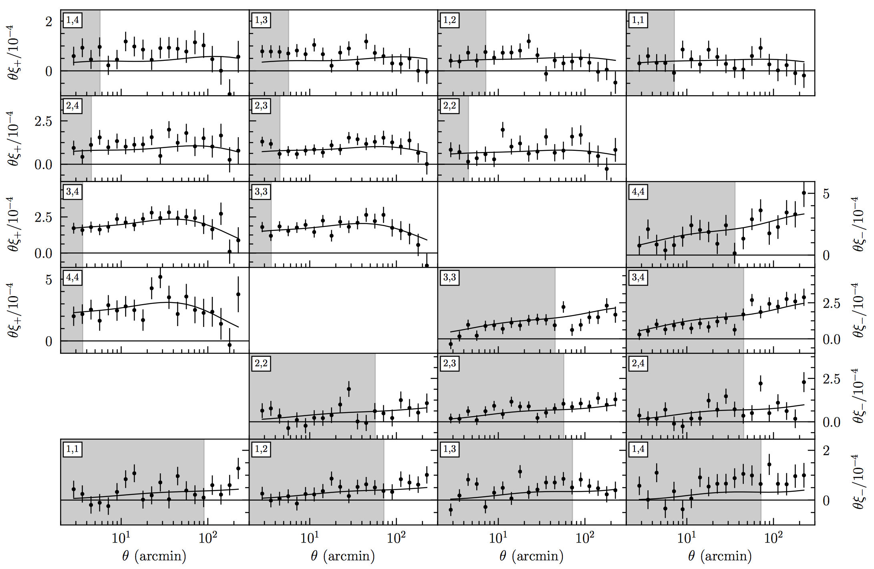
Weak lensing by large scale structure
CFHTLens (2000s)
KiDS, DES, HSC (2010s)
Lensing as a function of redshift bin and scale in DES
(Troxel et al. 2017)
DECam on the Blanco telescope in 2015
DECam in 2011 -- 520 Mpix CCD camera
(DES Fermilab gallery)

Slide 25
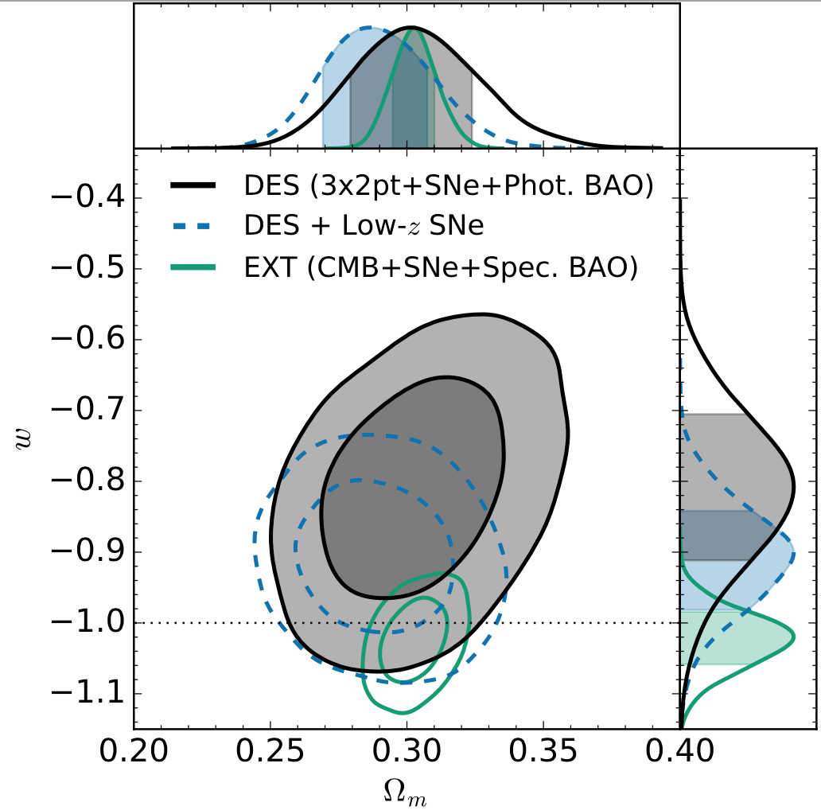
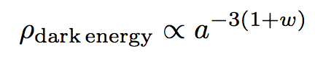
A Cosmological Constant?
Simplest explanation for cosmic acceleration: a cosmological constant, Λ
New addition to Einstein’s equation:
Current recent results consistent with a constant (w = −1)
Source of acceleration getting ← stronger weaker →
Dark Energy Survey, 2018

Slide 26
The Fate of the Universe?
In the far future, the expanding Universe empties out. Density and temperature approach zero.
R = 16 billion
light-years
In a finite amount of time, the Universe ends as even atoms and nuclei are torn apart!
Observable Universe becomes an inside-out black hole.
The “Big Rip”
The de Sitter spacetime
The “Big Freeze”

Slide 27
What is coming next?
Galaxy surveys to push to higher redshift and explore more of the Universe’s history (DESI, Euclid, LSST, WFIRST)
Cosmic microwave background as a back-light for lensing and scattering studies
New ways of observing the Universe – gravitational waves, diffuse 21 cm radiation
Maybe something we haven’t thought of yet?
You may get to be a part of this!

